Slide 1
Networked Control of Multi-agent Systems
Professor: Dominik Baumann
Advisor: Abdullah Tokmak
Aalto University, 20th May 2026
Julia Szewczyk, Marina Tavernier
Towards safe control parameter tuning in distributed
multi-agent systems

Slide 2
Real-world applications for safe distributed control
Agricultural
Swarms
Smart grids
Vehicle platooning
Mobile robots need to navigate unstructured terrain without damaging crops and human workers
Safety needed to prevent local voltage or frequency fluctuations that trigger blackouts
Warehouse intralogistics
Close, high-speed formation. Needs to be robust to disturbances
Search and rescue UAVs
Prevention of gridlocks, protection of staff even with sudden sensor degradation
High, unpredictable GPS-denied environments and sudden obstacles
Notes:
These five examples all share the same core challenge: multiple agents, limited communication, and strict safety requirements. Vehicle platooning is our simulation case — a single controller miscalibration can cause collisions. The others show this problem appears everywhere from power grids to warehouses.

Slide 3





Paper Summary
Goal: Optimize control parameters in distributed MAS while ensuring safety and sample efficiency
Safe policy optimization problem
$$\underset{a∈𝓐^{N}}{\max{f(a)}}$$
$$f\left(at\right)≥h,\text{∀ }\text{t}≥1$$
where
$f\text{:}𝓐^{N}→$ ℝ
: global reward function
subject to
$$h \text{∈} \text{ℝ}$$
: safety threshold
$$\text{t}$$
: Safe Bayesian Optimization iteration
Control parameters of each agent j : a_{t}^{(j)} ∈ $𝒜, j \text{∈} \text{\{}\text{1}\text{,}…,N\}$
Key challenge
NEAREST-NEIGHBOR COMMUNICATION
NON-OBSERVABLE SUBSPACES
DISCONTINUOUS LOCAL REWARD

Slide 4
Related literature
Distributed Optimization Methods
Safe Bayesian Optimization
Strong convergence but objective function needs to be known
Strong safety guarantiees using GPs but relies on global observability
Multi-Agent Reinforcement Learning (MARL)
Distributed Bayesian Optimization
Our assigned paper
Complex policies but sample inefficient and no safety guarantees
Improves scalability and communication, but focuses on optimization and not on safety
Solution to partial observability in a purely distributed setting with safety guarantees
Notes:
Each existing approach has a critical gap. MARL needs too much data and has no safety guarantees. Distributed optimization assumes convexity which rarely holds in practice. SafeOpt has strong safety guarantees but requires centralized global observations. Our assigned paper is the first to combine all three desiderata: fully distributed, sample-efficient, and safe — made possible by introducing time as a latent variable.

Slide 5
Paper Summary
Goal: Optimize control parameters in distributed MAS while ensuring safety and sample efficiency
Safe policy optimization problem
$$\underset{a∈𝓐^{N}}{\max{f(a)}}$$
$$f\left(at\right)≥h,\text{∀ }\text{t}≥1$$
where
$f\text{:}𝓐^{N}→$ ℝ
: global reward function
subject to
$$h \text{∈} \text{ℝ}$$
: safety threshold
$$\text{t}$$
: Safe Bayesian Optimization iteration
Control parameters of each agent j : a_{t}^{(j)} ∈ $𝒜, j \text{∈} \text{\{}\text{1}\text{,}…,N\}$
Key challenge
NEAREST-NEIGHBOR COMMUNICATION
NON-OBSERVABLE SUBSPACES
DISCONTINUOUS LOCAL REWARD

Slide 6
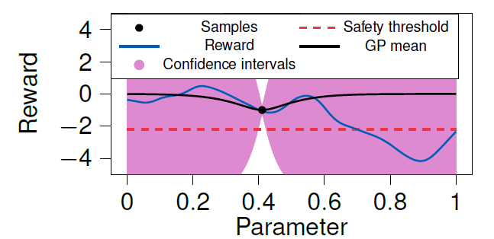

Gaussian Processes for Safe Bayesian Optimization
Unknown reward function
Expensive real-world evaluations
Need for sample-efficient learning
Need for uncertainty estimation
SafeOpt principle
Build confidence intervals
Explore safe actions only
Why use GPs?
Learn with GP
Define Safe Set using LCB
$$\text{LCB}\left(x\right)=μ\left(x\right)−βσ\left(x\right)$$
$$\text{safe} \text{if} \text{LCB}\left(x\right)≥h$$
Figure by Abdullah Tokmak, Towards safe control parameter tuning in distributed multi-agent systems, 64th IEEE Conference on Decision and Control (CDC 2025), December 11, 2025

Slide 7
Paper Summary - Solution
Latent variable
Introduce time as a latent variable to convert discontinuous local rewards into a learnable time-varying reward function
01
03
02
04
SAFEOPT
Spatio-temporal kernel
Safe Bayesian optimization (BO) algorithm with Gaussian process (GP)
Time-varying local interpretation of global static
reward function with custom spatio-temporal kernel

Slide 8
Our approach
Experimental validation
Connecting the GPs
Reward-over-iteration trajectories, comparing our decoupled approach against the baseline
One GP calculates a strict 'Safe Set,' which is then fed to the other one to safely guide the exploration of the Kp domain.
Main issue
A single Gaussian Process modeling both objectives and constraints creates ambiguity.
Platoon simulator
Simulator vehicle_class with scaled GP outputs to determine Kp controller gains for trucks
Decoupling the GPs
We instantiated independent GP models one for constraint and one for the objective

Slide 9
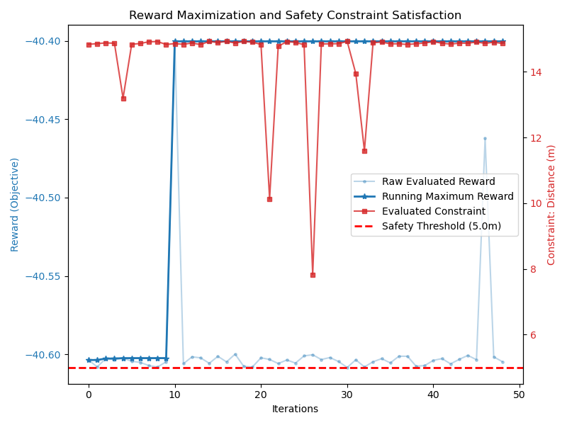
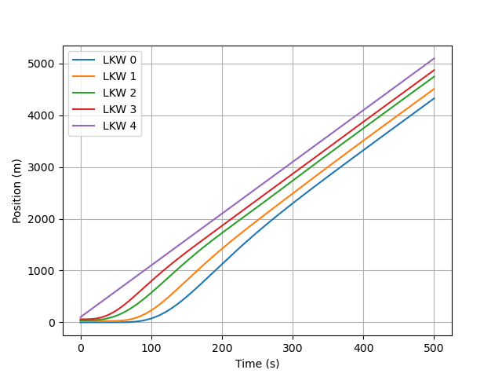
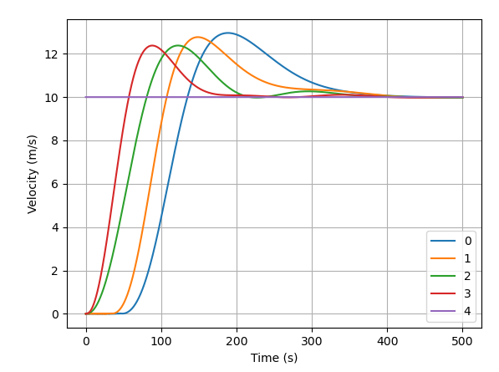
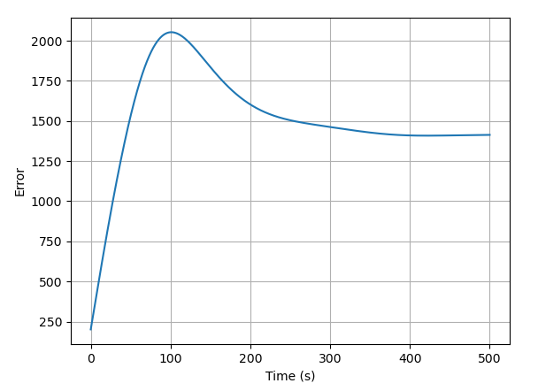
Findings
REWARD/ITERATION
TRAJECTORIES
SPEED
ERRORS
Safety is guaranteed but strong trade-off bewteen safety and Kp exploration. Important hyperparameter tuning
Trajectories are improved with better spacing, less rubber-band effect and strong dynamic stability
Attenuated peak transient velocities. Minimized braking demands. Safer velocity convergence
Convergence to constant, non-zero steady-state error. Prioritizing safe string-stability over perfect tracking

Slide 10
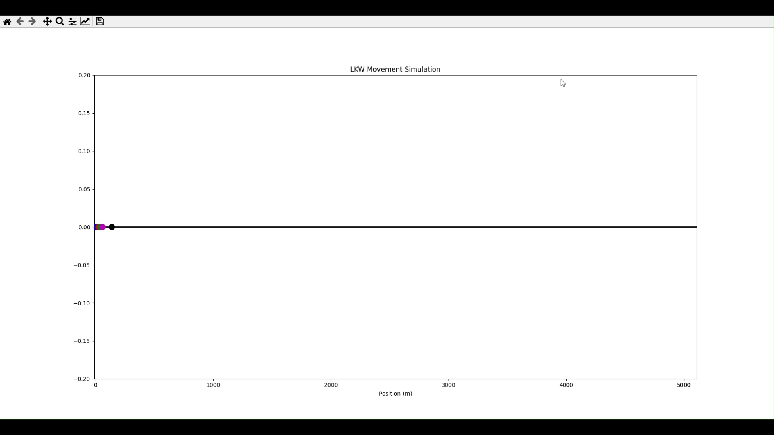
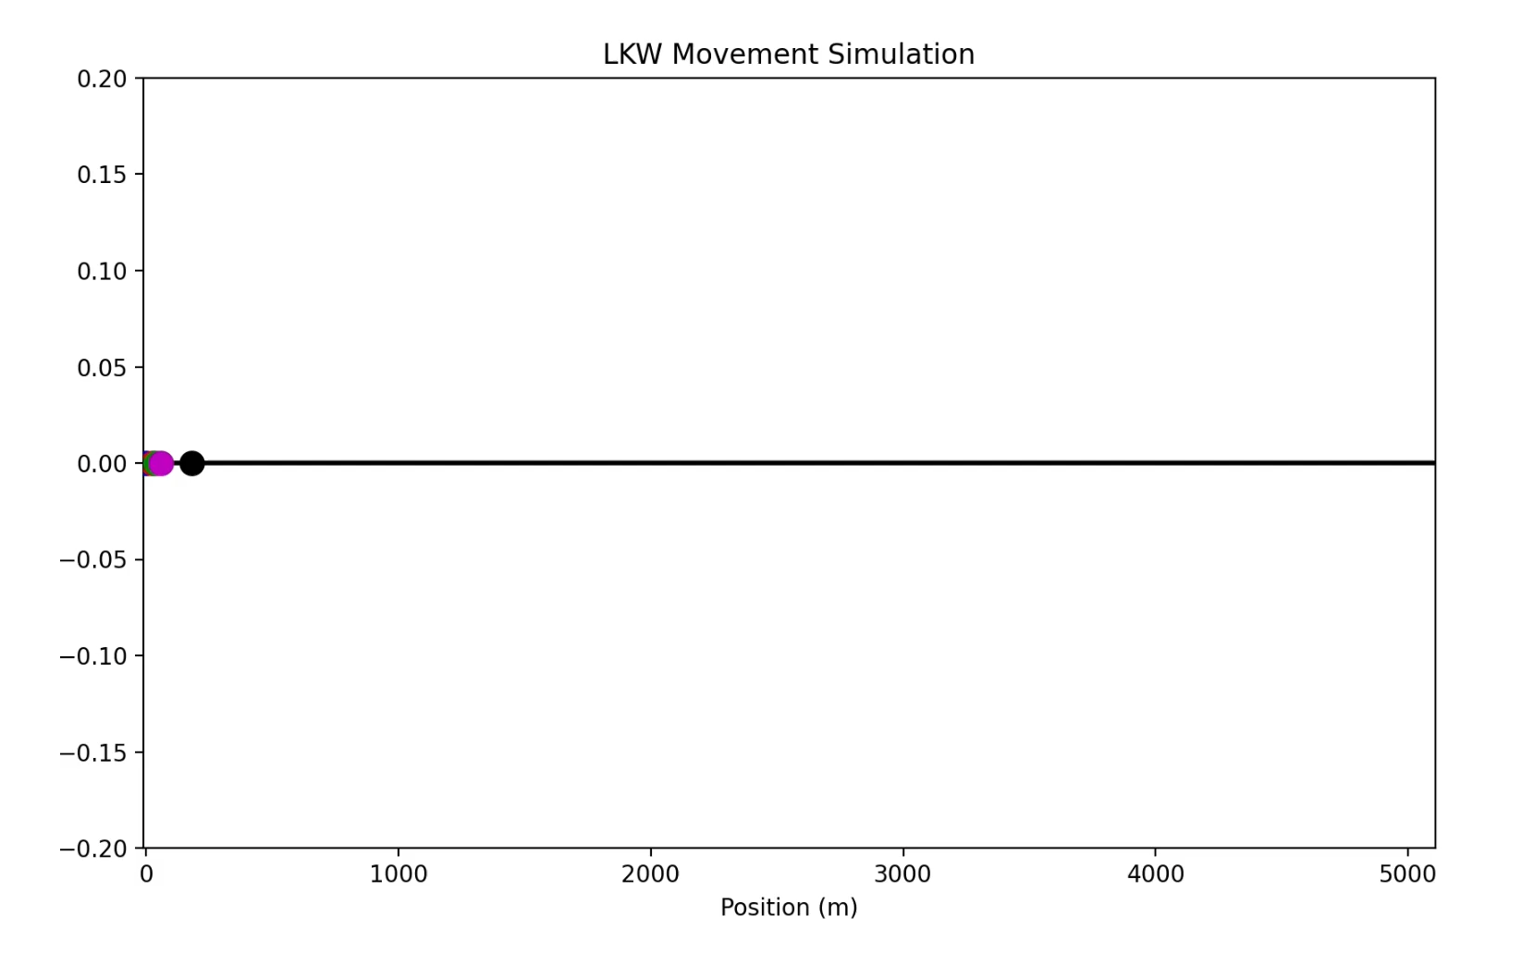
Simulations
Before
After

Slide 11
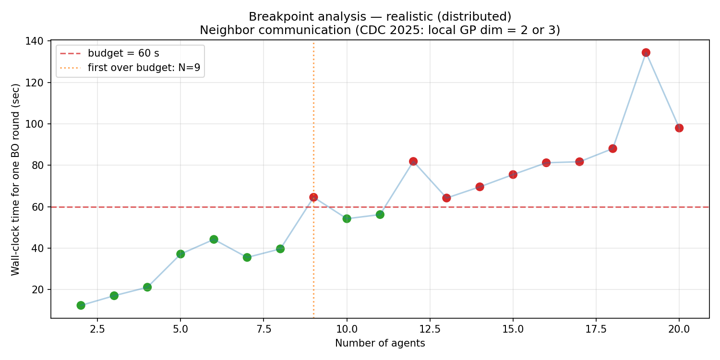
Scalability analysis
Avoiding Dimensional Collapse
Sequential Linear Bottleneck
Operational Break-Points
01
02
03
05
Using localized GPs and nearest-neighbour communication
GP models evaluated sequentially
The system supports up to 8 agents under 60-second budget

Slide 12
Conclusions & Future Outlook
Decoupled architecture
Safety-Exploration trade-off
Scalability and bottlenecks
Advancing Kernel structures
Formalizing safety protocols
Solution to single-GP instabilities and guarantees of zero-collisions
Forcing strict safety pushes the algorithm into conservative Kp exploration
Per-round compute time scales linearly, parallelization not needed for 8 agents
Refining of the spatio-temporal kernel to model on a better time variable
Need to provide officially verifiable safety guarantees

Slide 13
Any questions?

